Slide 1
ENSE 470, Milestone 7
[Group name]
[Group members]
[Date of report-out]

Slide 2
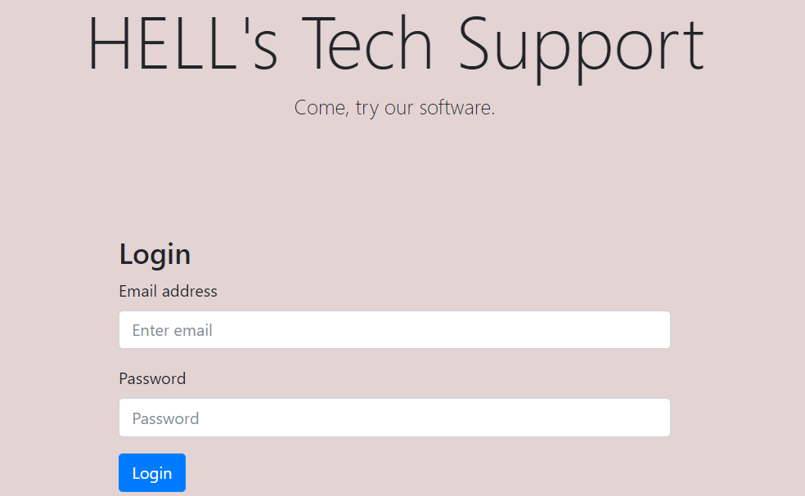
Introduction
Hells Tech Support

Slide 3
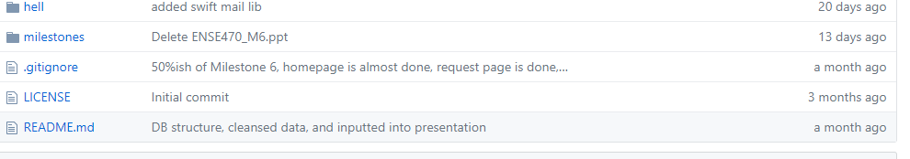
Team GitHub review
Is the team’s GitHub readable? Yes
Does the team provide good documentation?
Readme has not been updated since milestone 4
Is your team able to understand the file/folder names/structure (flow)?
Code is split up nicely until DB and SRC folders and each milestone has its own folder
Would your team be able to easily and quickly pick up where they left off?
Yes, modifying their code would be easy given the excellent layout

Slide 4
Refactor review (High-level focus)
Is the team’s code obvious/readable for other programmers
Most of the code is easy enough to understand and follow
However, there are ZERO comments which make more complex files difficult to read
Do all tests pass?
I was unable to find any of their ATDD tests on the GitHub
Each of their ATDD tests included in Milestone 5 PowerPoint passes
Code smells
Lack of comments
Their inputs are not sanitized
We could have dropped tehir tables but we are nice :)
Duplicate code in the manage.php file
Identical code except for one line in each Modal. These modals could be each a class

Slide 5
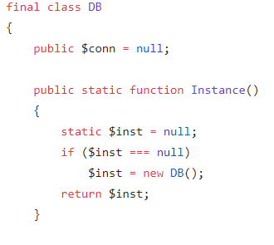
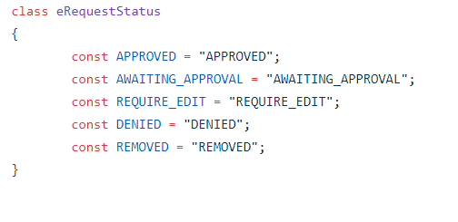
Design pattern discussion (High-level focus)
Singleton was used on the database connection
Composite was used to display success and failure Modals
Model was used through the use of MySQL in the backend to store the data

Slide 6
Reviewed team’s response
Ask the reviewed team if they have any questions or comments. This in the spirit of positive non/critical discussion and/or debate

Slide 7
Group reflection
How did you feel about this milestone? What did you like about it? What did you dislike?
This milestone was unique and an interesting way for each team to get feedback on their project
What did you learn about yourself as you collaborated and worked through this milestone?
It's quite a bit of fun trying to break other people's code
How will you use what you have learned going forward?
This technique of peer editing will become more useful as we move on to the work place.
What “stuff & things” related to this milestone would you want help with?
This was simple enough

